Slide 1
IRAD Program Review – Cloud Computing Data Processing
^{February 2019}

Slide 2
Cloud Computing Data Processing
Project Dashboard - 1
Project Overview
Technical Approach
Multiple Mission Solutions customers and programs and opportunities such as IRON PATRIOT, UNICORN, ENDEAVOUR, CATCHFIRE, and ATHENA have a significant focus on moving operations into the cloud. This shift in direction makes it imperative we keep our technical approaches and knowledge up to date in this area.
The Cloud Computing Data Processing IRAD will take advantage of components, such as EC2, RDS, EMR, and CloudWatch, provided by cloud computing services for resource allocation.
The goal is to create an engine and a framework that will facilitate the addition and integration of additional resources such as virtual machines to system.
The end product will provide:
  Graphical User Interface to configure the system and to manage components
  Basic modules to interact with the different components from the cloud provider
  An engine that will tie them together
  An easy to use configuration page
We propose implementation of this IRAD to be cloud agnostic, but tested on AWS. We think this approach is reasonable because of some important government implementations of IC-ITE, such as C2S and GovCloud, are built on AWS.
Our approach will leverage the results of our previous CCDP IRAD development activities and associated intellectual property and patents.
  Framework Development
    Develop web-based configuration page
    Optimize current configuration approach
    Replace current heartbeat monitoring/reporting approach
    Improve task and thread management web based tool
Notes:
07/29/17

Slide 3
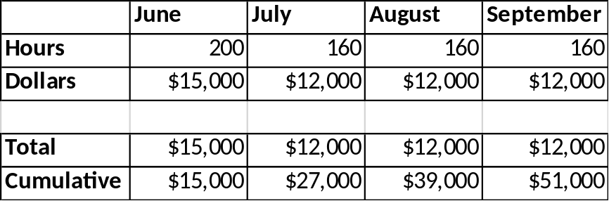
Cloud Computing Data Processing
Project Dashboard - 2
Spend Plan
Execution Plan
Total Budget
  $50k
Amazon Web Services Cluster
  Continuous use of Amazon Web Services to run and test the system
Labor
  Development hours required to implement and/or integrate the following components: GUI, engine, and database
  Candidates
    Oscar Ganteaume
    Junior Developer (TBD)
Near Term
  Continue the testing and bug fixing to the engine and framework
  Incorporate the use of another cloud providers such as Google Cloud and Azure
Long Term Objectives (at completion)
  Develop web-based configuration page
  Optimize current configuration approach
  Improve monitoring/reporting approach
Deliverables
  Virtual machine image containing engine and implemented APIs for Graphical User Interface
  Deployment scripts to launch and configure the system

